Slide 1

Data Lakes
Session 3
Sandra Pico Oristrell
December 2023

Slide 2
Agenda
Part 1: Theory (1:30h)
Introduction to Data Lakes
Comparison with Data Warehouses and Databases
How do you build a Data Lake in AWS?
AWS Glue Data Catalog
AWS Lake Formation
Modern Data Lake Architectures
Resources
Break (15 min)
(45 min) Use case: Create a secure data lake with AWS Lake Formation
Part 2: Hands-on (30min)
AWS Educate: Getting Started with Storage (Amazon S3)

Slide 3
Big Data on AWS
Session 3: Data Lakes
Data Sources
Data Storage
Batch Processing
Analytics Storage
Reporting
Machine Learning
Real-time Ingestion
Streaming processing

Slide 4
Part 1: Theory

Slide 5
Introduction to Data Lakes

Slide 6
Introduction to Data Lakes
Databases vs Data Warehouse vs Data Lakes
Databases
Data Warehouse
Data Lakes

Slide 7

Introduction to Data Lakes
Database summary (Session 2)
A database is a collection of data or information that are typically used to support Online Transaction Processing (OLTP). Database Management Systems (DBMS) store data in the database and enable users and applications to interact with the data. There are a variety of databases with its own characteristics. Relational databases store data in tables with fixed rows and columns, while non-relational databases (NoSQL) store data in a variety of models (e.g., JSON, key-value pairs, nodes and edges…).
Why use a database?
If your application needs to store data, your applications needs a databases. Some examples below:
Store patient medical records
Store IoT device readings
Store Online gaming information
Store Financial records
…

Slide 8
Introduction to Data Lakes
Online Analytical Processing (OLAP) : Data Warehouses and Data Lakes
OLAP systems are typically used to collect data from variety of sources. The data is then used to power a range of analytical use cases ranging from business intelligence and reporting to forecasting algorithms, as example. Both data warehouses and Data Lakes are meant to support OLAP.

Slide 9
Introduction to Data Lakes
Data Warehouses
Stores highly structured information from various data sources
to analyze the data.
Typically store current and historical data from one or more systems.
Highly optimized for analytics.
The ETL processes move data on the regular schedule, so data in the data
Warehouse may not reflect the most up-to-date of the systems.
Business analysts can connect data warehouses with BI tools.
Good option when you need to store large amount of historical
Data and perform in-depth analysis of your data to generate BI.
Not intended to satisfy the transaction and concurrency
needs of an application.
Data warehouse
ETL
ETL
ETL
Database
Database
Database

Slide 10
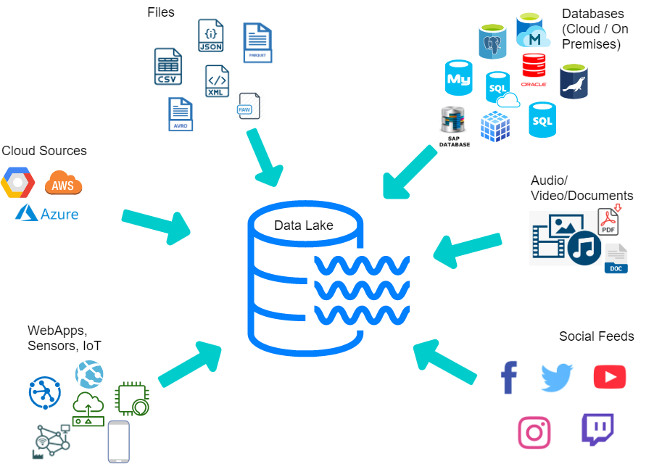
Introduction to Data Lakes
Data Lakes
A data lake is a repository of data from disparate sources that is stored
in its original, raw format. Like data warehouses, data lakes store large
amounts of current and historical data.
What sets data lake apart is their ability to store data
in a variety of formats including JSON, CSV, Parquet, JPG, MP4, PDFs…
Data Lakes store large amounts of structured, semi-structured and unstructured data.

Slide 11

Introduction to Data Lakes
Data Lakes and Datawarehouse consumers
Data warehouse
Data Analysts
Data Lakes
Data Engineers
Data Scientists

Slide 12
Key differences: Databases, Data Warehouses and Data Lakes
 | Databases | Data Warehouse | Data Lake
Workloads | Typically, OLTP | OLAP | OLAP
Data type | Structured or semi-structured | Structured and/or semi-structured | Structured, semi-structured and/or un-structured
Schema Flexibility | Rigid or flexible schema depending on database type | Pre-defined and fixed schema definition for ingest | No schema definition required for ingest
Data Freshness | Real-time | May not be up-to-date based on frequency of ETL | May not be up-to-date based on frequency of ETL
Users | Application developers | Business analysts and data scientists | Data Engineers, Application developers, and data scientists
MongoDB Source
MongoDB Source

Slide 13
Key differences: Databases, Data Warehouses and Data Lakes
 | Databases | Data Warehouse | Data Lake
PROS | Fast queries for storing and updating data | The fixed schema makes working with the data easy for business analysts | Easy data storage simplifies ingesting raw data. A schema is applied afterwards to make working with the data for BA. Separate storage and compute.
CONS | May have limited OLAP capabilities | Difficult to design and evolve schema. Scaling compute may require unnecessary scaling of storage – because they are coupled. | Requires effort to organize and prepare data for use
MongoDB Source

Slide 14









Introduction to Data Lakes
Databases vs Data Warehouse vs Data Lakes – AWS Storage Services
Databases
Data Warehouse
Data Lakes
Amazon Aurora
Amazon Relational Database Service (Amazon RDS)
Amazon DynamoDB
Amazon Redshift
Amazon Simple Storage Service (Amazon S3)
Amazon DocumentDB
Amazon Timestream
Amazon ElastiCache
Amazon Neptune

Slide 15
How do you build a Data Lake in AWS?

Slide 16
What do we need?
The need of a Data Lake
A centralized repository that allows you to store all your structured and unstructured data at any scale

Slide 17
How do we achieve it?
Amazon S3
Amazon Simple Storage Service (Amazon S3) is an object storage service that offers industry-leading scalability, data availability, security, and performance. Customers of all sizes and industries can use Amazon S3 to store and protect any amount of data for a range of use cases, such as data lakes, websites, mobile applications, backup and restore, archive, enterprise applications, IoT devices, and big data analytics.
Amazon S3 provides management features so that you can optimize, organize, and configure access to your data to meet your specific business, organizational, and compliance requirements.
Amazon Simple Storage Service (Amazon S3)

Slide 18
Data Lake design
Lift and shift is not always the best approach.
Consider current and future business needs.
Decisions you make upfront matter.
Placement, format, ingestion, access and more.
Consider ecosystem integration.
Design for security and compliance
Amazon Simple Storage Service (Amazon S3)

Slide 19


Organize your data at scale
AWS Account
Bucket 1/internal/users/
Bucket 1/internal/billing/
Bucket 1/internal/free/usage
Department = Finance
Team = Business Reporting
Classification = Confidential
Bucket 1
Bucket 2/model1/train/
Bucket 2/model2/train/
Bucket 2/model1/inference/
Department = Marketing
Team = Data Science
Classification = Confidential
Bucket 2
Buckets
Prefixes
Object tags

Slide 20
Organize your data at scale
Prefix design to scale
3500
5500
PUT/COPY/POST/DELETE
GET/HEAD
Per prefix

Slide 21

Example: Autonomous vehicles
A bunch of cars are sitting at a central location.
Every day they embark, drive around, and collect a bunch of data.
Return home (at about the same time) and upload all the data that they collect into the data lake.

Slide 22
Example: Autonomous vehicles
/daily-uploads/<date>/<car>/drive-data
Amazon Simple Storage Service (Amazon S3)

Slide 23
Example: Autonomous vehicles
/daily-uploads/20231211/CAR01/drive-data/
/daily-uploads/20231211/CAR02/drive-data/
/daily-uploads/20231211/CAR08/drive-data/
/daily-uploads/20231211/CAR01/drive-data/
/daily-uploads/20231211/CAR04/drive-data/
/daily-uploads/20231211/CAR01/drive-data/
/daily-uploads/20231211/CAR08/drive-data/
/daily-uploads/20231211/CAR07/drive-data/
Amazon Simple Storage Service (Amazon S3)

Slide 24
Example: Autonomous vehicles
Let’s re-design our data lake structure
/daily-uploads/ac/20231211/CAR01/drive-data/
/daily-uploads/1f/20231211/CAR02/drive-data/
/daily-uploads/dd/20231211/CAR08/drive-data/
/daily-uploads/ca/20231211/CAR01/drive-data/
/daily-uploads/25/20231211/CAR04/drive-data/
/daily-uploads/ef/20231211/CAR01/drive-data/
/daily-uploads/dd/20231211/CAR08/drive-data/
/daily-uploads/10/20231211/CAR07/drive-data/
Amazon Simple Storage Service (Amazon S3)
Best practices design patterns: optimizing Amazon S3 performance - Amazon Simple Storage Service

Slide 25
Object design: Size and formats matter
Size
Aim for large objects that are 2-16 MB+
Reduces TPS on your prefixes
Lowers cost on requests and storage management features
Reduces fewer query objects

Slide 26
Object design: Size and formats matter
Size
Aim for large objects that are 2-16 MB+
Reduces TPS on your prefixes
Lowers cost on requests and storage management features
Reduces fewer query objects
Format
Carefully choose your formats
Widely adopted formats tend to have a wider ecosystem
Columnar formats: compact sizes, better performance, predicate pushdowns
Amazon S3 Select: Natively supports a range of formats

Slide 27

Amazon S3: Strong Consistency
AZ
Data ingestion workloads
AZ
Analytics, Machine Learning workloads
Amazon S3
AZ

Slide 28








Choose a storage class for your data
Optimize your cost
Access pattern
Duration of storage
S3 Standard
S3 Intelligent- Tiering
S3 Standard-IA
S3 One Zone-IA
S3 Glacier Flexible Retrieval
S3 Glacier Deep Archive
S3 Glacier Instant Retrieval
S3 on Outposts
Object Storage Classes – Amazon S3

Slide 29
Multi-tiered data lake architecture
Improve data quality
Tier 1 / Raw zone /
Bronze
Tier 2 / Curated zone
/ Silver
Tier 3 / Refined zone
/ Gold

Slide 30
The data lake ecosystem
Amazon Simple Storage Service (Amazon S3)
Data lake

Slide 31


The data lake ecosystem
Data governance and catalog
AWS Lake Formation
AWS Glue
Amazon Simple Storage Service (Amazon S3)
Data lake

Slide 32



The data lake ecosystem
Ingest Services
Data governance and catalog
AWS Lake Formation
AWS Glue
Amazon Simple Storage Service (Amazon S3)
AWS Lambda
Amazon Simple Storage Service (Amazon S3)
Amazon Kinesis
AWS DataSync
Data lake

Slide 33



The data lake ecosystem
ETL and Catalog
Data governance and catalog
AWS Lake Formation
AWS Glue
Amazon EMR
AWS Lambda
Amazon Simple Storage Service (Amazon S3)
AWS Glue Data Catalog
Crawler
AWS Glue
Data lake

Slide 34

The data lake ecosystem
Analyze
Data governance and catalog
AWS Lake Formation
AWS Glue
Amazon EMR
Amazon Athena
Amazon Simple Storage Service (Amazon S3)
Amazon Redshift
Data lake

Slide 35
AWS Glue Data Catalog

Slide 36
AWS Glue Data Catalog
The AWS Glue Data Catalog is a centralized metadata repository for all your data assets across various data sources. It provides a unified interface to store and query information about data formats, schemas and sources.
Whan an AWS Glue ETL job runs, it uses this catalog to understand information about the data and ensure that is transformed correctly.
The data catalog is composed of the following components:
Databases and tables
Crawlers
Connections
Schema registry
AWS Glue Data Catalog - AWS Prescriptive Guidance (amazon.com)

Slide 37
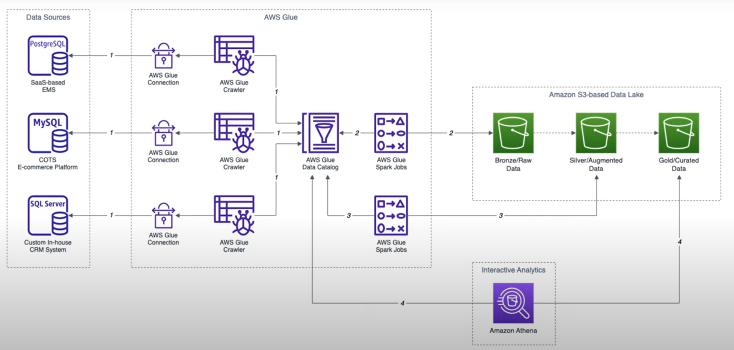
Sample architecture
(1) Building Data Lakes on AWS: Build a simple Data Lake on AWS with AWS Glue, Amazon Athena, and S3 - YouTube

Slide 38
AWS Lake Formation

Slide 39
Some challenges when securing Data Lakes
Securing and Governing Your Data Lake
Challenge #1 : Security and Governance
Managing permissions at scale is difficult and error-prone.
Challenge #2: Data Sharing
Sharing data across accounts and organizations is cumbersome.

Slide 40
AWS Lake Formation
Securing and Governing Your Data Lake
Build data lakes quickly
Move, store and catalog your data faster
Simplify security management
Centrally define security, governance, and auditing policies in one place
Provide self-service access to data
Build a catalog of datasets
Define user access policies
AWS Lake Formation

Slide 41
AWS Lake Formation: Security Model
Why is managing data lake permissions hard?
Unifying permissions across
the data lake stack
Enforcing fine-grained permissions to restrict access
Ensuring data access complies with regulations
Split storage, metadata and compute
Each system has different permissions
Syncing permissions is error prone
Data lakes contain a lot of data
Users should only access portions
1000 of resources and 10.000 of users
Democratize data access
Regulations and governance
Monitor and audit data access

Slide 42
AWS Lake Formation permissions model
Unified S3 permissions
Integrated with Services and tools
Easy to audit permissions and access
DB style fine-grained permissions on resources
Scale permissions management AWS Lake Formation Tag Based Access Control (LF-TBAC)
AWS Lake Formation
(1) Simplifying Permissions and Governance in your Data Lake - AWS Online Tech Talks - YouTube

Slide 43
Modern Data Lake Architectures

Slide 44



Modern data lakes architectures
Data sources
Data Catalog
Purpose built storage
Analytics
Amazon Redshift
Amazon Athena
Tier 1
Glue job
Tier 2
Glue job
Amazon QuickSight
Tier 3
Glacier
Modern data lake architectures – AWS Summit ATL 2022
Amazon SageMaker

Slide 45
Use case

Slide 46

Create a secure data lake with AWS Lake Formation
Create a secure data lake by masking, encrypting data and enabling fine-grained access
Create a secure data lake by masking, encrypting data, and enabling fine-grained access with AWS Lake Formation | AWS Big Data Blog (amazon.com)
Reading time
30 min
Discussion time
10 min

Slide 47
Resources

Slide 48
Resources
The content of this section was based on the following resources:
Comparison of Data Lakes, Data Warehouse and Databases by MongoDB
AWS Educate: Getting Started with Storage
Data Lakes in AWS, multiple sources:
Building a Data lake on Amazon S3
Building Data Lakes on AWS
Securing and Governing your Data Lake with AWS Lake Formation
Build a Lake House Architecture on AWS | AWS Big Data Blog (amazon.com)
Modern Data Lakes with AWS Lake Formation, Amazon Redshift and AWS Glue
Data Lake foundations – Storage Best Practices for Data and Analytics Applications
Some additional workshops to keep learning on the session domain below:
AWS Lake Formation Workshop (workshops.aws)

Slide 49
Part 2: Hands-on

Slide 50
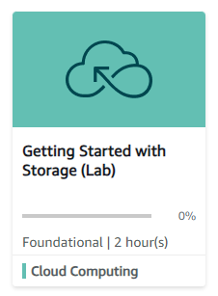
Hands-on Labs
AWS Educate Labs
1
Getting Started with Storage (Amazon S3)
Link
Getting Started with Storage (instructure.com)
Lab duration
~ 30 minutes
Description
In this lab, you use come of the Amazon Simple Storge Service (Amazon S3) features that you just learned about to create a static website. Static websites can contain HTML pages, images, style sheets and all files that are needed to render a website.

Slide 51
Thank you

